Slide 1
Motion in Different Reference Frames
Edward Murphy
Ian Costley
May 4, 2018

Slide 2
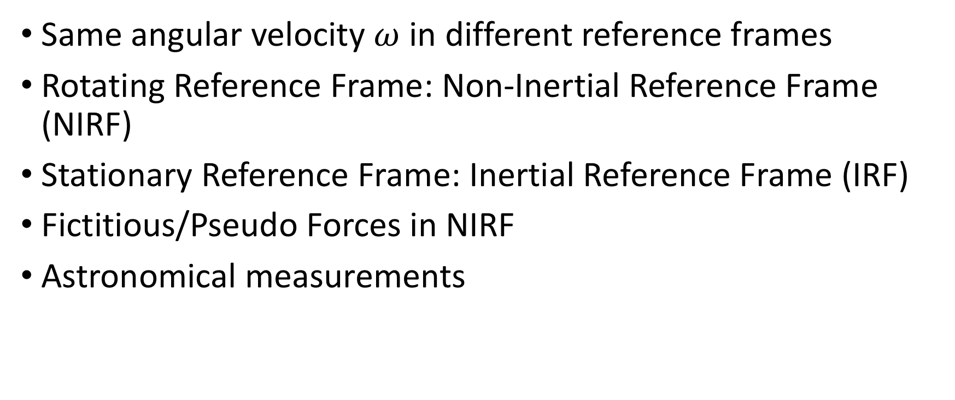
Introduction
Same angular velocity $ω$ in different reference frames
Rotating Reference Frame: Non-Inertial Reference Frame (NIRF)
Stationary Reference Frame: Inertial Reference Frame (IRF)
Fictitious/Pseudo Forces in NIRF
Astronomical measurements

Slide 3
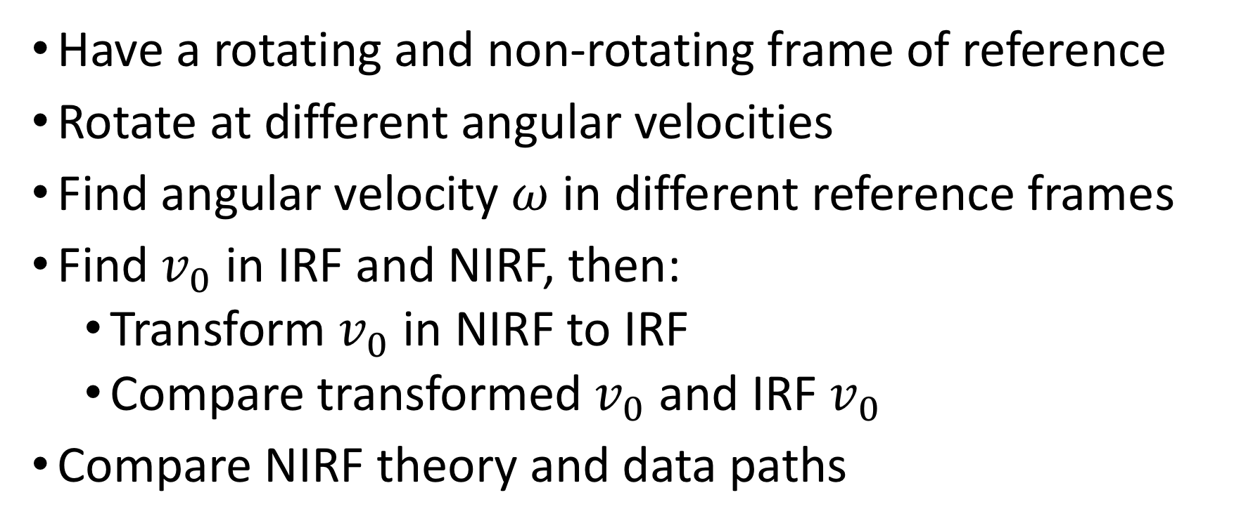
Goal
Have a rotating and non-rotating frame of reference
Rotate at different angular velocities
Find angular velocity $ω$ in different reference frames
Find $v_{0}$ in IRF and NIRF, then:
Transform $v_{0}$ in NIRF to IRF
Compare transformed $v_{0}$ and IRF $v_{0}$
Compare NIRF theory and data paths

Slide 4
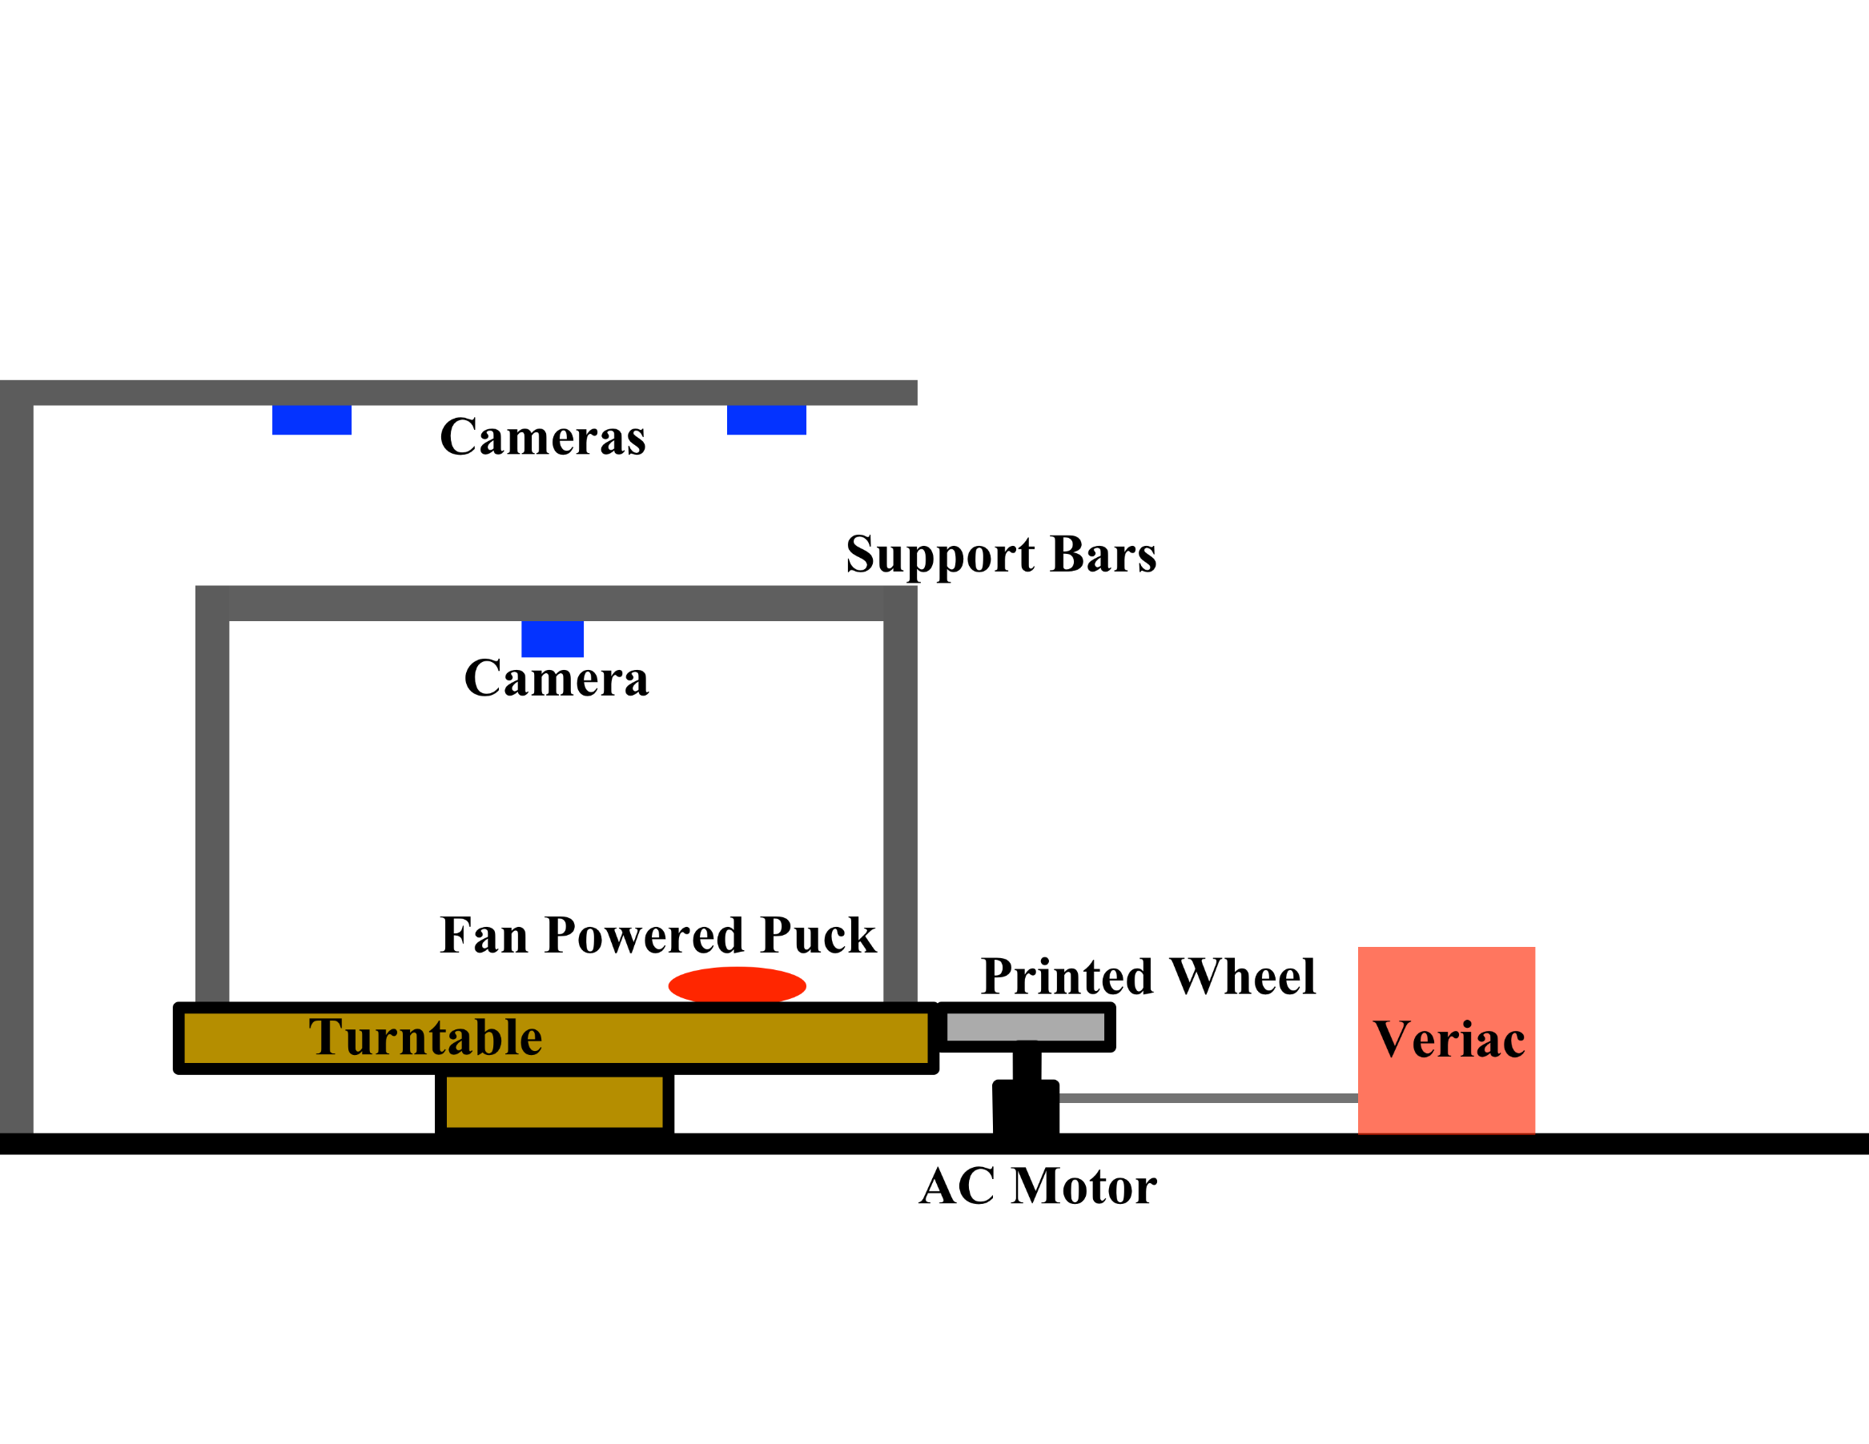
Setup

Slide 5
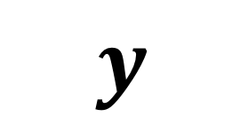
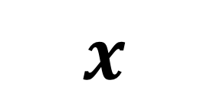
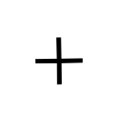
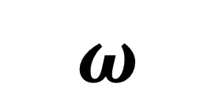
Setup
Rotating Table
NIRF Camera
View
$$y$$
$$×$$
$$ω$$
$$x$$
Hover Puck
Notes:
116 cm diameter for rotating tables
Hover puck diameter - 9 cm

Slide 6
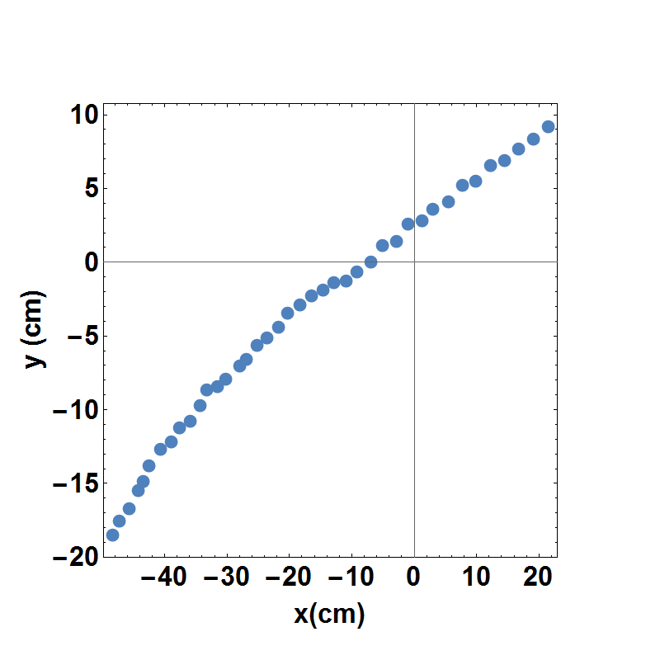
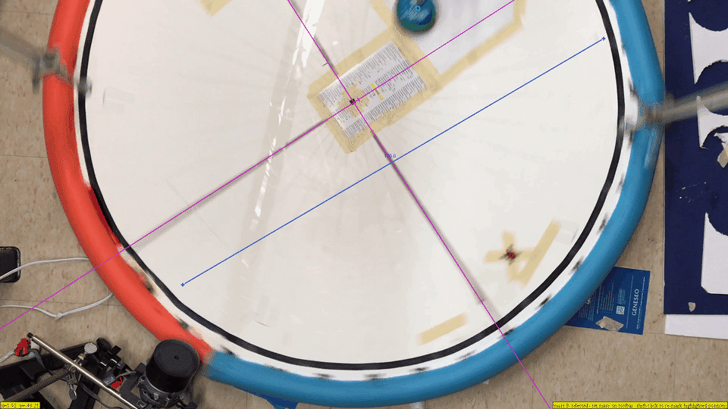
Data
Tracking Puck - Inertial Reference Frame

Slide 7
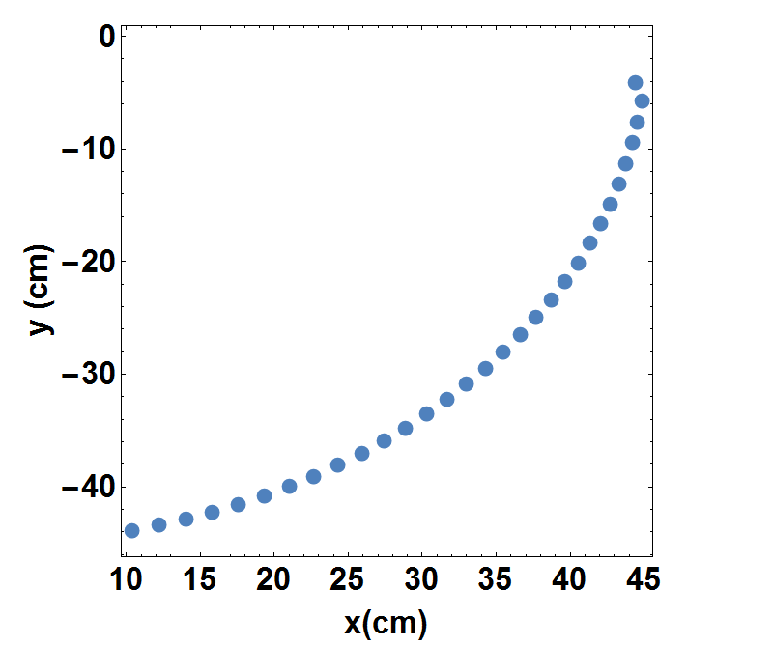
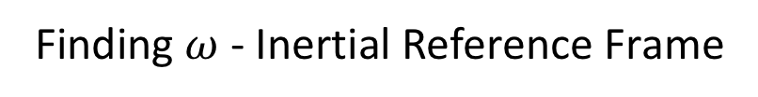
Data
Finding $ω$ - Inertial Reference Frame

Slide 8
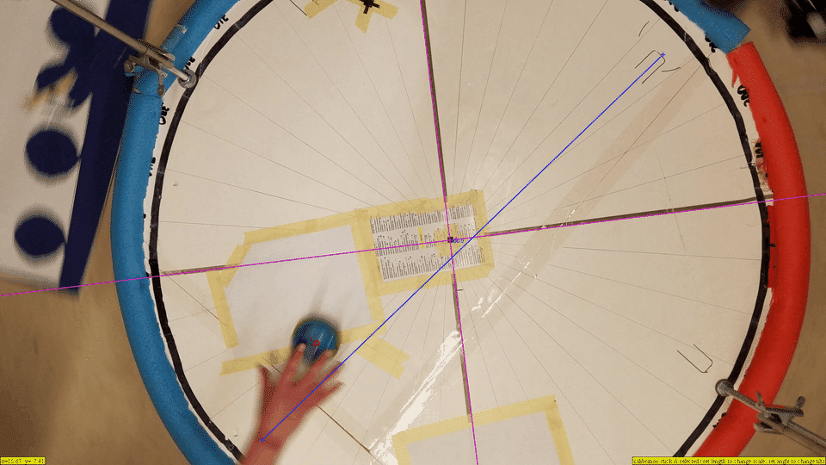
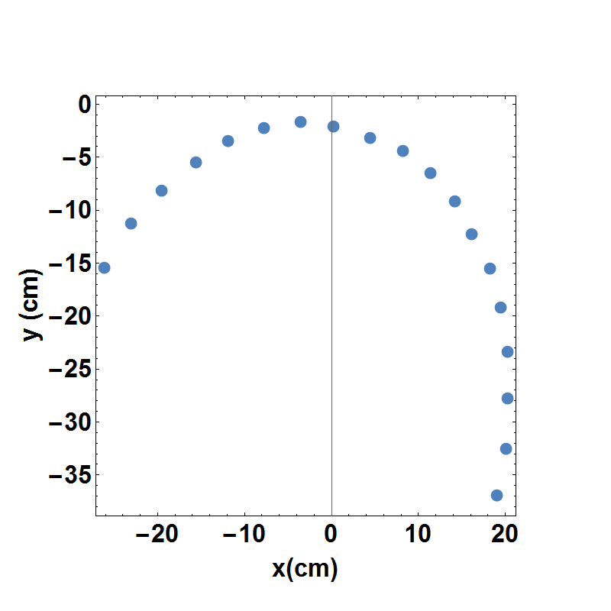
Data
Tracking Puck - Non-Inertial Reference Frame

Slide 9
Data
Non-Inertial Reference Frame
Inertial Reference Frame

Slide 10
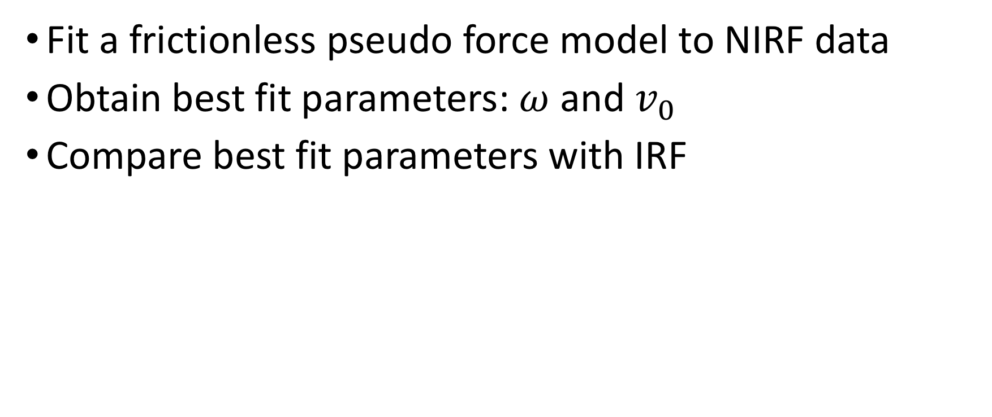
Data Analysis
Fit a frictionless pseudo force model to NIRF data
Obtain best fit parameters: $ω$ and $v_{0}$
Compare best fit parameters with IRF

Slide 11
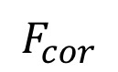
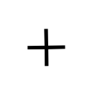
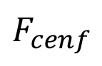
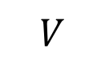
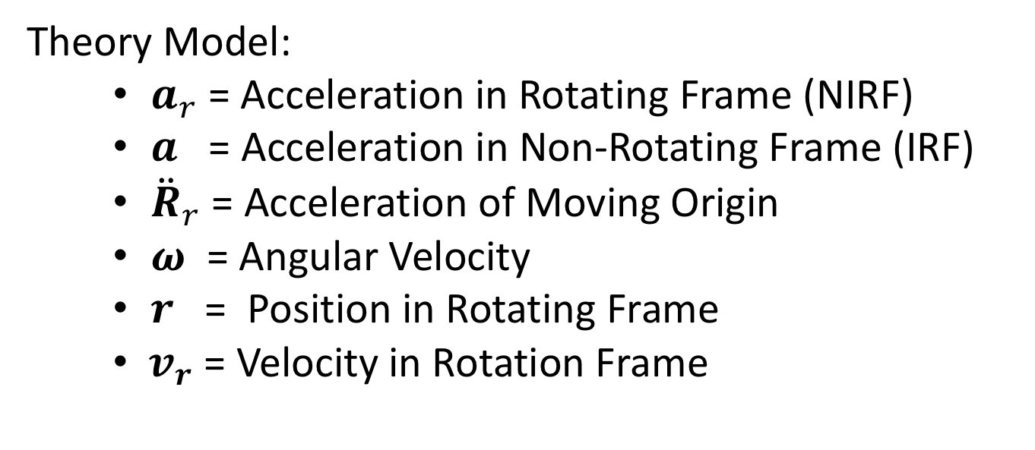
Theory
Centrifugal Force
Coriolis Force
$$a_{r}=a−{\ddot{R}}_{r}−\dot{ω}×r−ω×\left(ω×r\right)−2(ω×v_{r})$$
Theory Model:
$a_{r}$= Acceleration in Rotating Frame (NIRF)
$a$ = Acceleration in Non-Rotating Frame (IRF)
${\ddot{R}}_{r}$= Acceleration of Moving Origin
$ω$ = Angular Velocity
$r$ = Position in Rotating Frame
$v_{r}$ = Velocity in Rotation Frame
Notes:
Said origin is not moving and angular velocity is constant so it reduces to the next slide

Slide 12
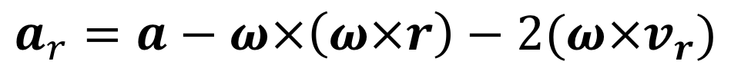
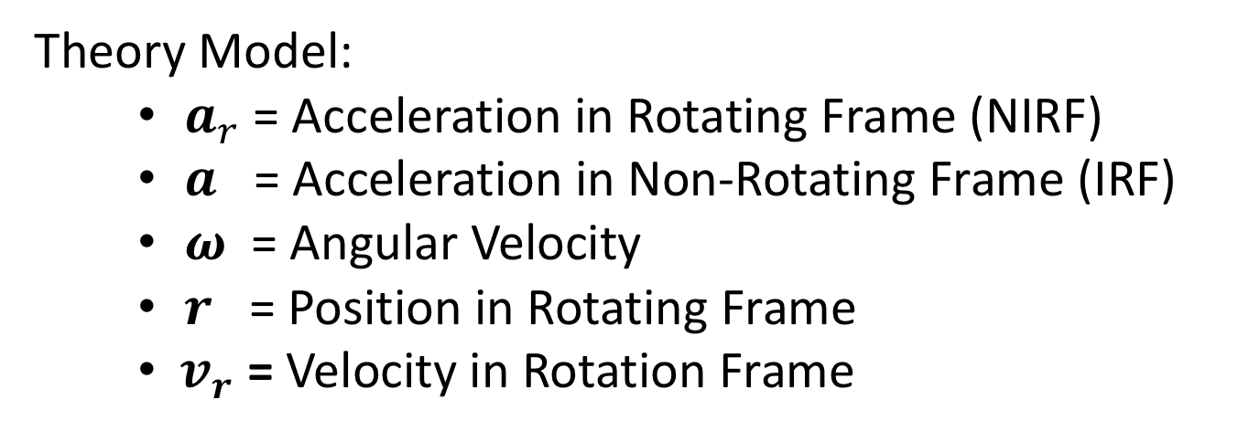
Theory
Centrifugal Force
Coriolis Force
$a_{r}=a−ω×\left(ω×r\right)−2(ω×v_{r})$
Theory Model:
$a_{r}$= Acceleration in Rotating Frame (NIRF)
$a$ = Acceleration in Non-Rotating Frame (IRF)
$ω$ = Angular Velocity
$r$ = Position in Rotating Frame
${ v}_{r}$ = Velocity in Rotation Frame

Slide 13
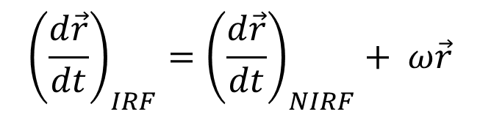
Theory
$${\left(\frac{d\vec{r}}{dt}\right)}_{IRF}={\left(\frac{d\vec{r}}{dt}\right)}_{NIRF}+ ω×\vec{r}$$
Translation of NIRF Velocity

Slide 14
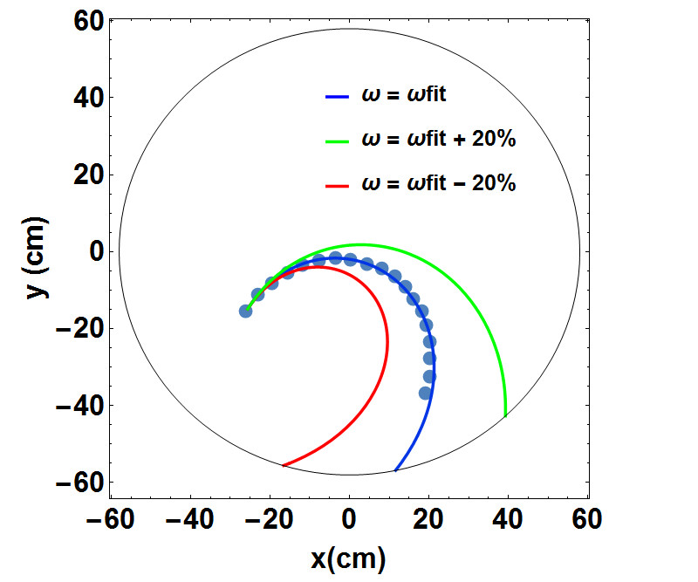
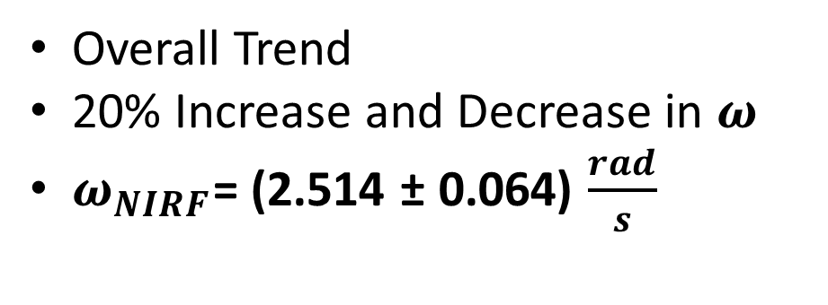
Results: Trial One
Overall Trend
20% Increase and Decrease in $ω$
$ω_{NIRF}$= (2.514 ± 0.064) $\frac{rad}{s}$

Slide 15
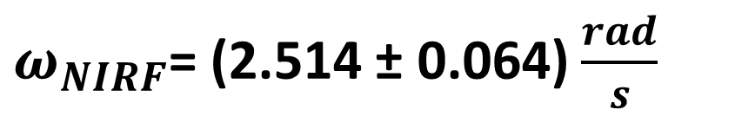
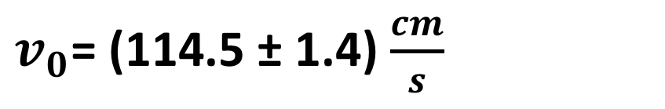
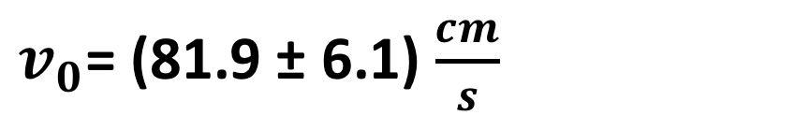
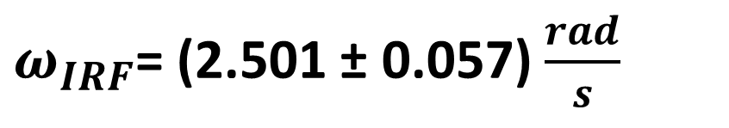
Results: Trial One
$ω_{NIRF}$= (2.514 ± 0.064) $\frac{rad}{s}$
$ω_{IRF}$= (2.501 ± 0.057) $\frac{rad}{s}$
$v_{0}$= (81.9 ± 6.1) $\frac{cm}{s}$
$v_{0}$= (114.5 ± 1.4) $\frac{cm}{s}$
Transformation to IRF
From IRF Data

Slide 16
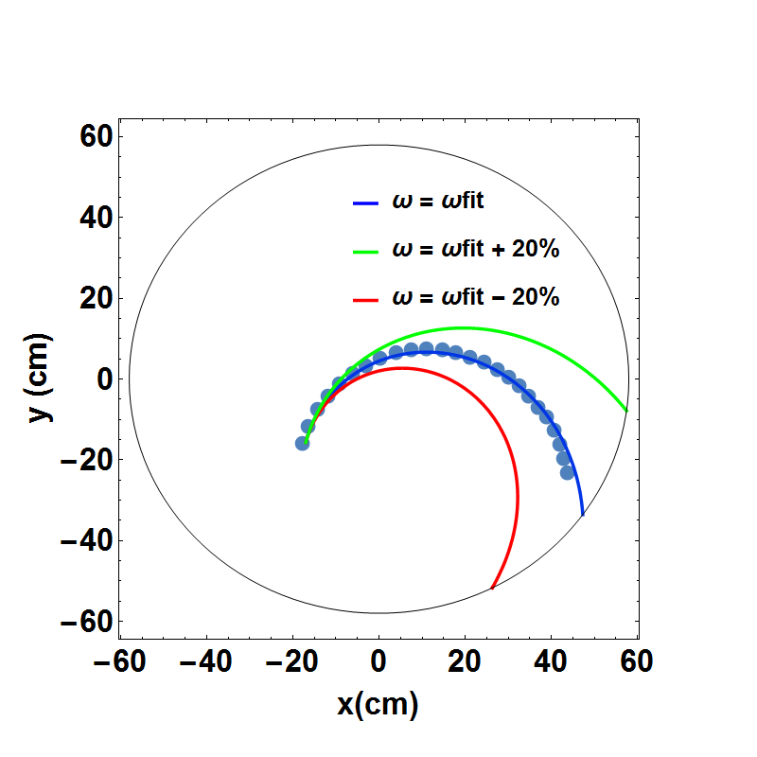
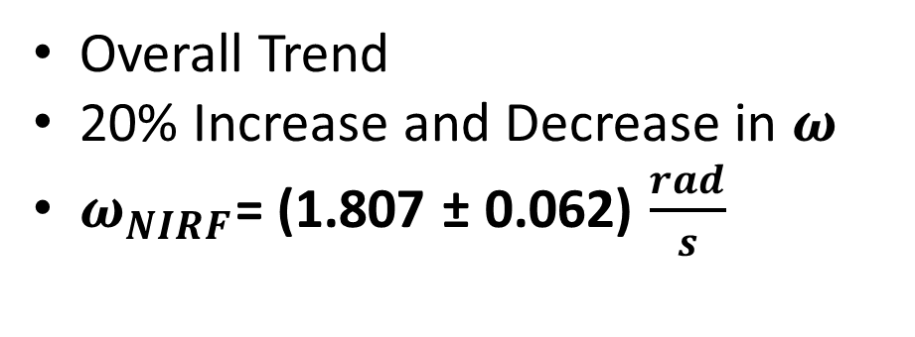
Results: Trial Two
Overall Trend
20% Increase and Decrease in $ω$
$ω_{NIRF}$= (1.807 ± 0.062) $\frac{rad}{s}$

Slide 17
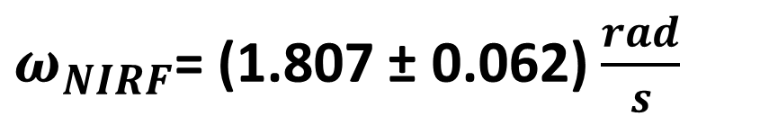
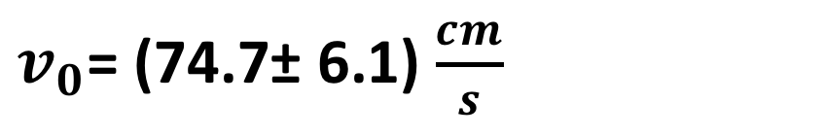
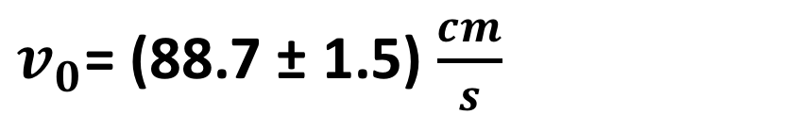
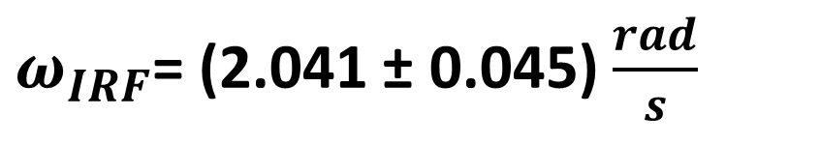
Results: Trial Two
$ω_{NIRF}$= (1.807 ± 0.062) $\frac{rad}{s}$
$ω_{IRF}$= (2.041 ± 0.045) $\frac{rad}{s}$
$v_{0}$= (74.7± 6.1) $\frac{cm}{s}$
$v_{0}$= (88.7 ± 1.5) $\frac{cm}{s}$
Transformation to IRF
From IRF Data

Slide 18
Results

Slide 19
Possible Sources of Error
Unleveled Rotating Platform
Vibrations in NIRF Camera
Uneven Surface
Parallax of Camera Lens
Uneven Weighting of Hockey Puck

Slide 20
Summary
Should see same angular velocities
IRF velocities should match
Theory and observed paths
Improvements

